Slide 1
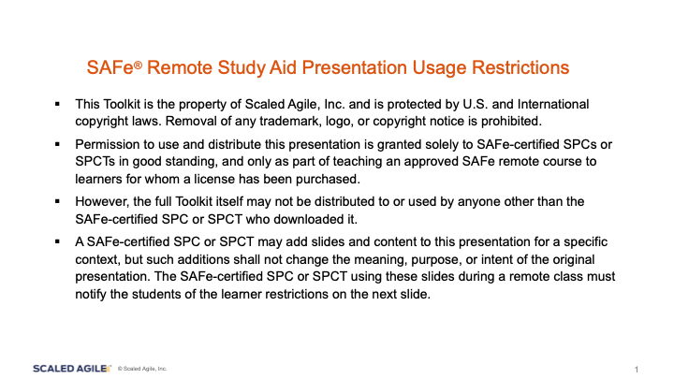

Slide 2
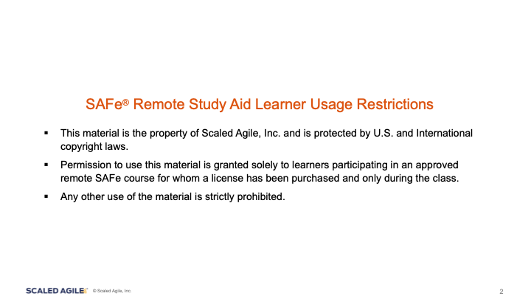

Slide 3
SAFe Product Owner/Product Manager 5.0
Remote Class Aid
Group Template

Slide 4

Group Activity Worksheets
2.9 Discussion - Just Enough Pre-Planning
Activity 2-41 - Feature Refinement
Activity 4-19 - Write Acceptance Criteria
Activity 4-44 - Estimate Stories
2.19 Activity - Create Epics to Fulfill the Vision
Activity 2-57 - Prioritizing the Program Backlog
Activity 4-21 - Split Stories
2.27 Activity - Consider market rhythms for optimum release timing
Activity 2-61 - Draft Your Capacity Allocation Policy
Activity 4-28 - Develop a Story Map
Activity 2-40 - Decompose an Epic using Feature storming
Activity 4-14 - Decompose Features into Stories
Activity 4-44 - Estimate Stories

Slide 5
Video Library for the Course
1-7 - TTC History and Business Context - https://vimeo.com/296743657/e22b54b952
2-4 - SAFe at TravelPort: The Power of PI Planning - https://vimeo.com/356905724/60d2ba24bf
2-12 - TTC All Hands - https://vimeo.com/310890102/890a0eaa12
3-28 - The Program Board - https://vimeo.com/355401474/4ed0fa500e
4-30 - Running an effective SAFe Iteration Planning Meeting - https://vimeo.com/299054038/ae429609f1
4-51 - Running an Effective SAFe DSU - https://vimeo.com/289123257/0de749d63e
4-59 - How to Run an Effective SAFe Iteration Review Meeting - https://vimeo.com/309353242/e486372f18
4-66 - How to Run an Effective SAFe Iteration Retrospective - https://vimeo.com/289517223/5216eafd10
4-70 - What is DevOps? - https://vimeo.com/342037390/3a25026214
4-71 - The Continuous Delivery Pipeline - https://vimeo.com/342037858/f10a115479
5-31 - The Retrospective and Problem-Solving Workshop Overview - https://vimeo.com/351678406/ce4e8a1cfa
6-3 - SAFe Certification Benefits - https://vimeo.com/307578726
6-4 - Welcome to the SAFe Community Platform - https://vimeo.com/201877314

Slide 6
Activity Worksheets
<Group name>

Slide 7
Activity 2-9 – Just Enough Pre-Planning
Think about SAFe core values and principles as well as different SAFe practices that influence or enable PI planning preparedness.
More pre-Planning
s | s
s | s
Positive
Negative
Less pre-Planning

Slide 8

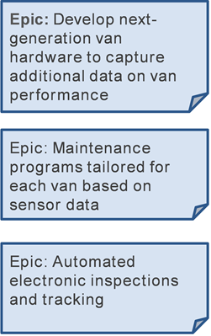
Activity 2-19 - Create Epics to Fulfill the Vision
Prepare
Share
5
10
[Create one additional Epic here]
Notes:
►The Van Maintenance Advisor is a substantial new offering. It will consist of several Epics representing significant development initiatives.
►Working as a team, review these three Epics that support the Van Maintenance Advisor offering. Can you add one additional Epic?

Slide 9
Activity 2-27 - Consider market rhythms for optimum release timing
Notes:
►The System Architect has informed the Product Management team that Customers will have to take their vans out of service for approximately one day to install the new hardware required by the Van Maintenance Advisor.
►Approximately 1/3 of your van Customers are serving the the local retail market while 1/3 are serving the medical specimen market.
►Step 1: Draw a market rhythms chart with one line for each market segment to help determine when you could release the new hardware to minimize disruptions to your customers.
►Step 2: Be prepared to share with the class.

Slide 10
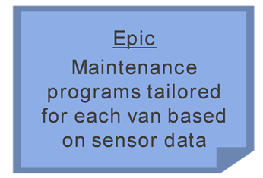
Activity 2-40 - Decompose an Epic using Feature storming
[Create additional Features]
[Create additional Features]
[Create additional Features]
[Create additional Features]
[Create additional Features]
[Create additional Features]
[Create additional Features]
[Create additional Features]
[Create additional Features]
Notes:
►Step 1: Working in your groups, decompose this Epic by creating as many Features as possible
–Leverage the Mike the Fleet Manager persona and Solution Context to help create a more complete set of Features
►Step 2: Be prepared to share with the class.

Slide 11
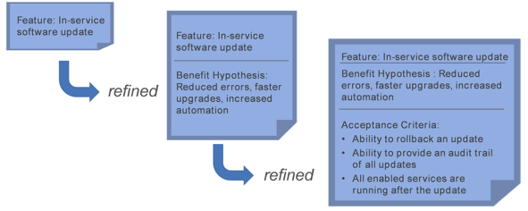
Activity 2-41 - Feature Refinement
Description:
Benefit Hypothesis:
Acceptance Criteria:
Description:
Benefit Hypothesis:
Acceptance Criteria:
Description:
Benefit Hypothesis:
Acceptance Criteria:
Notes:
►Step 1: Take three of the Features that you have created. Using a flip chart, refine them with a description, benefit hypothesis, and acceptance criteria.
►Step 2: Identify who is the primary beneficiary of acceptance criteria.
►Step 3: Be prepared to share with the class.

Slide 12
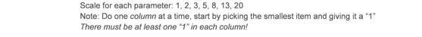
Activity 2-57 - Prioritizing the Program Backlog
Feature | User- Business Value |  | Time Criticality |  | RR or OE |  | Cost of Delay |  | Job Size |  | WSJF
 |  | + |  | + |  | = |  | / |  | =
 |  | + |  | + |  | = |  | / |  | =
 |  | + |  | + |  | = |  | / |  | =
Notes:
►Step 1: Select three Features from the previous activity and prioritize them using the WSJF template in your workbook
►Step 2: Do one column at a time. Start by picking the smallest item and giving it a “1.” There must be at least one number “1” in each column of the template.
►Step 3: Be prepared to share your WSJF prioritization.

Slide 13
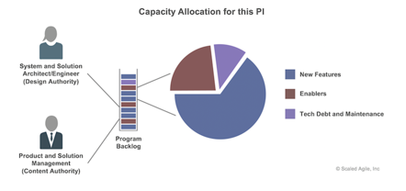
Activity 2-61 - Draft Your Capacity Allocation Policy
Capacity allocation policies
Notes:
►Step 1: Consider how you would use capacity allocation in your Enterprise
►Step 2: Draft a capacity allocation policy that you could bring back for discussion with your key collaborators
►Step 3: Be prepared to share with the class

Slide 14
Activity 3-14 – Communicate the Vision
Vision
Notes:
►Step 1: Consider how you would use capacity allocation in your Enterprise
►Step 2: Draft a capacity allocation policy that you could bring back for discussion with your key collaborators
►Step 3: Be prepared to share with the class

Slide 15
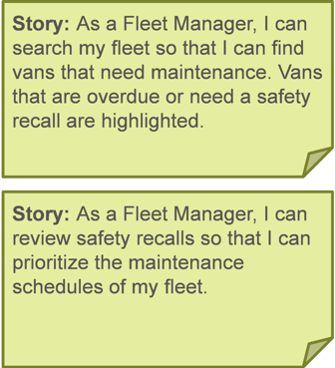
Activity 4-14 - Decompose Features into Stories
As a (user role)
I want to (activity)
So that (business value)
As a (user role)
I want to (activity)
So that (business value)
As a (user role)
I want to (activity)
So that (business value)
As a (user role)
I want to (activity)
So that (business value)
As a (user role)
I want to (activity)
So that (business value)
As a (user role)
I want to (activity)
So that (business value)
Notes:
►Step 1: With your group, select three Features you created and decompose these Features into Stories
►Step 2: Write these Stories in the User Story format:
–As a (user role) I want (activity) so that (business value).

Slide 16
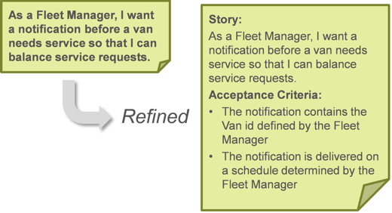
Activity 4-19 - Write Acceptance Criteria
As a (user role)
I want to (activity)
So that (business value)
Acceptance Criteria
Given
When
Then
As a (user role)
I want to (activity)
So that (business value)
Acceptance Criteria
Given
When
Then
As a (user role)
I want to (activity)
So that (business value)
Acceptance Criteria
Given
When
Then
Notes:
►Step 1: With your group, write acceptance criteria in the Given-When-Then format for three Stories you have created.
►Step 2: Make sure the acceptance criteria are testable.
►Step 3: Discuss with your group:
–Did writing acceptance criteria in the Given-When-Then format identify the need for any additional details?

Slide 17
Activity 4-21 - Split Stories
As a (user role)
I want to (activity)
So that (business value)
Acceptance Criteria
Given
When
Then
As a (user role)
I want to (activity)
So that (business value)
Acceptance Criteria
Given
When
Then
As a (user role)
I want to (activity)
So that (business value)
Acceptance Criteria
Given
When
Then
Notes:
►Choose a Story from the ones you created that may not fit into an Iteration and, with your table group, split it.
►How can you ensure that split Stories provide end-user value?

Slide 18
Activity 4-28 - Develop a Story Map
Activity or Task
Activity or Task
Activity or Task
Activity or Task
Activity or Task
Activity or Task
Story
Story
⬆Essentials
⬇Improvements
Story
Story
Story
Story
Story
Story
Story
Story
Story
Story
Story
Story
Story
Story
Notes:
►Story maps are useful even when there are a small number of steps in the workflow.
►Step 1: With your group, create a Story map for this Story and answer these questions:
–What are the main tasks?
–What is the minimum number of Stories required to accomplish the user’s goal?
–What Stories can make the user’s workflow easier?
►Step 2: Be prepared to share with the class.

Slide 19
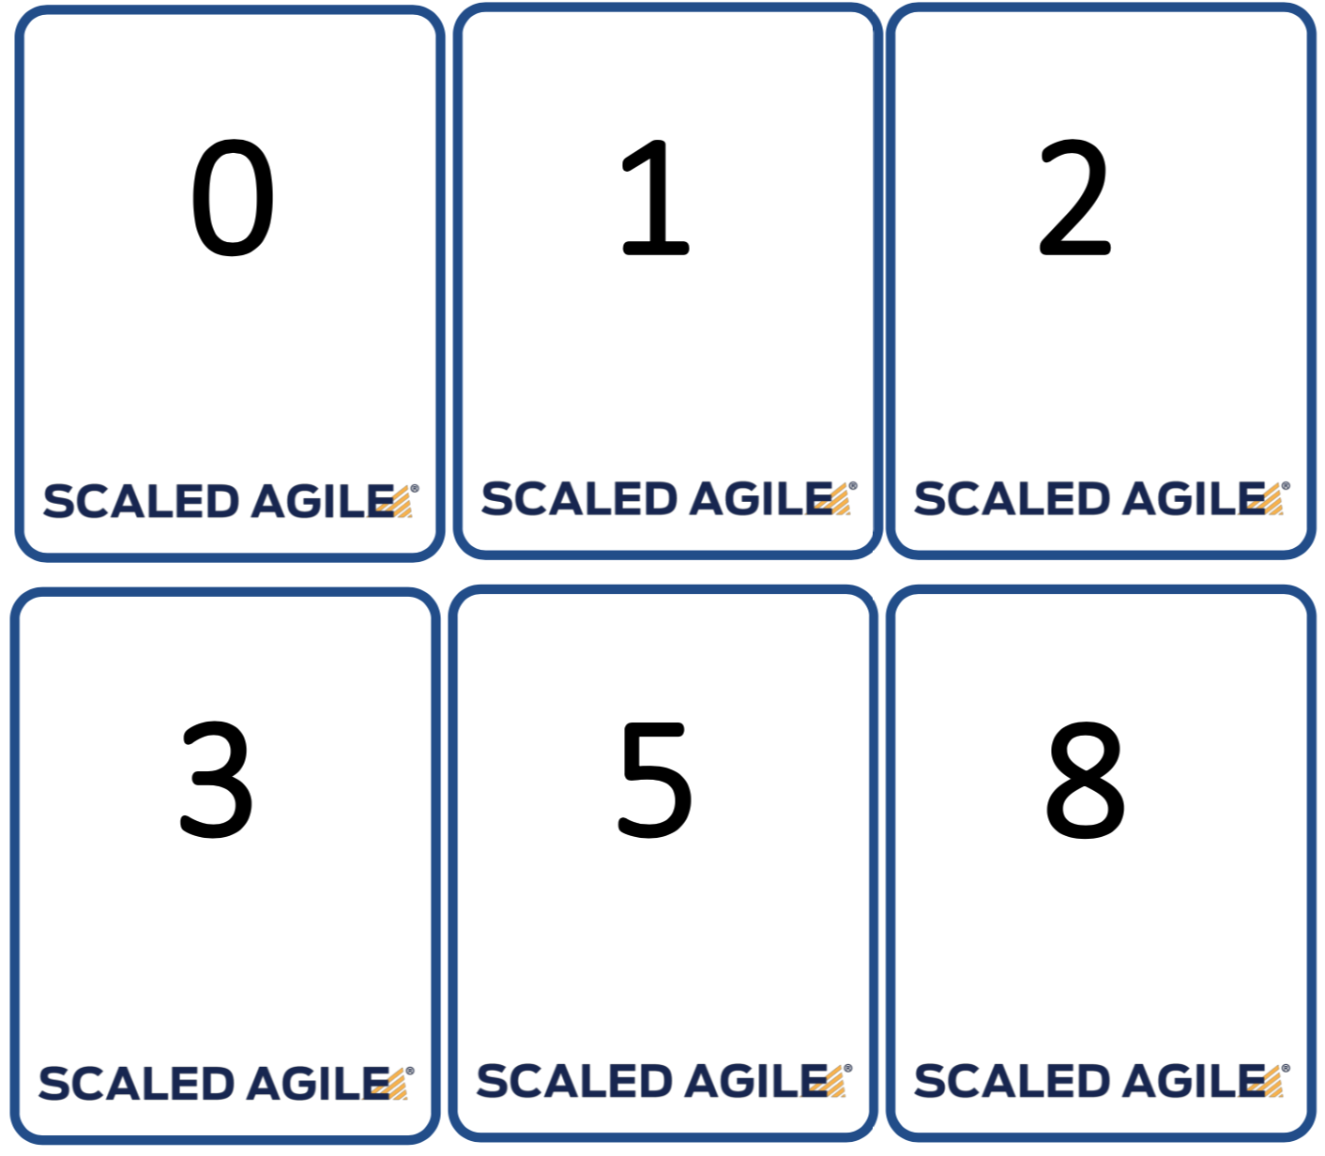
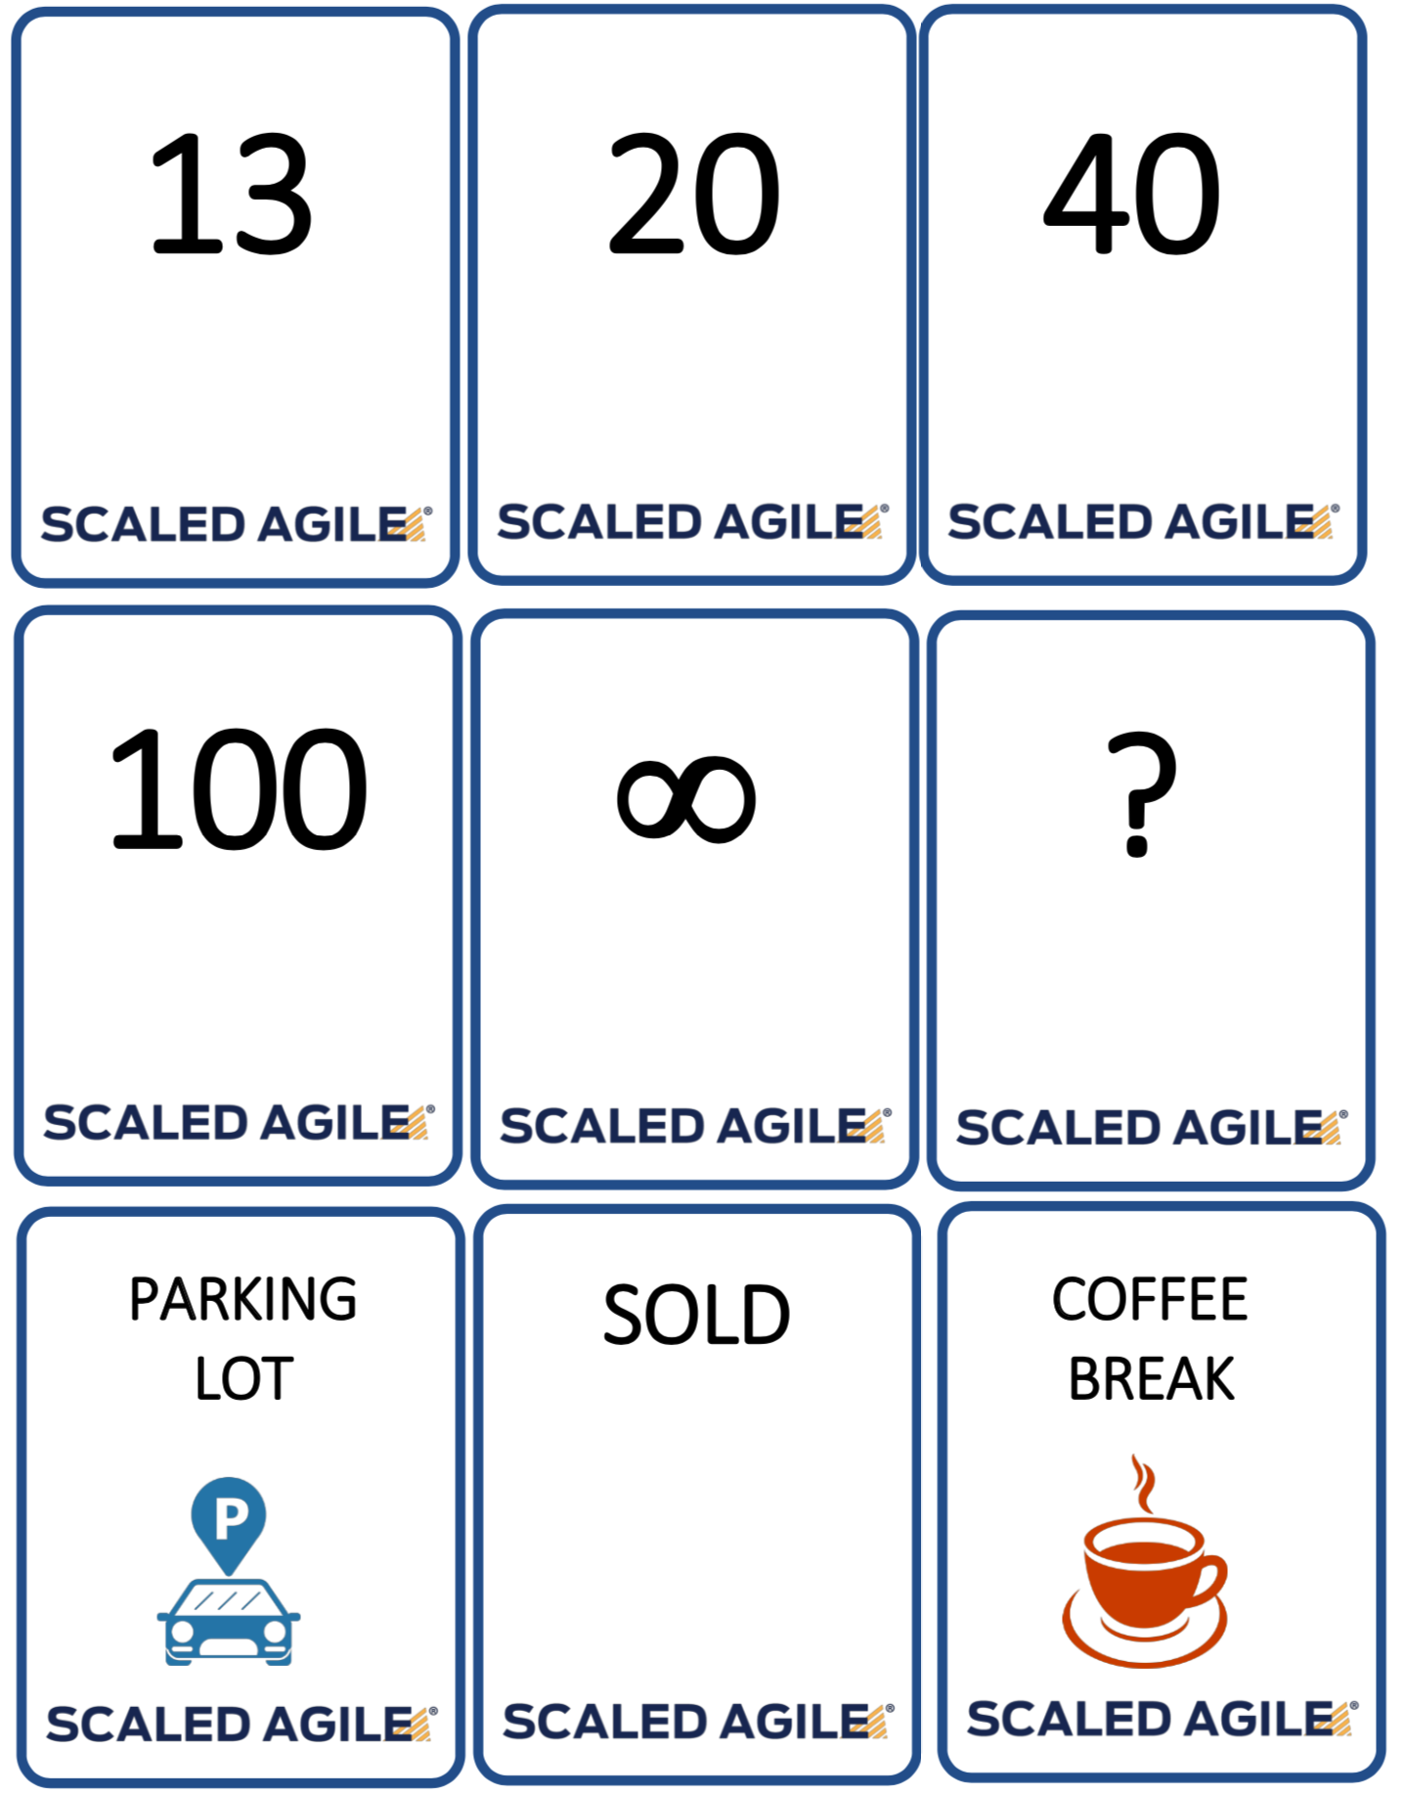
Activity 4-44 - Estimate Stories
[Copy your stories from slide 15 here to add estimates]
Each person chooses a marker below and places it on their vote
Notes:
►Step 1: With your table group, use the Estimating Poker cards to estimate the Stories you previously created.
►Step 2: Share with the class:
–Where do you find challenges when engaged in Story estimation?
–Are you as a team aligned around the combination of qualities that represent a Story point (volume, complexity, knowledge, uncertainty)?

